Slide 1
District A15 Lions Learning Library
Club LCIF Coordinator
23-07-24 R4

Slide 2
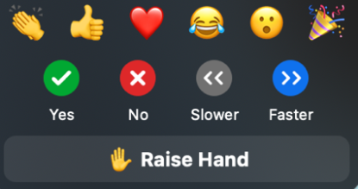
Club LCIF Coordinator
Zoom Meeting-Tips
“Mute” your microphone
-Mute is in lower left corner, if there is a red line through the microphone,
you are muted.
Asking Questions- Use the “chat”
-Click on the Chat button, type your question. There will be a Lion watching the chat room for questions.
Raise your “hand” to ask a question
-Click “reactions”, then click “raise hand”. Remember to click on “raise hand” after your question to turn the hand off.

Slide 3
Club LCIF Coordinator

Slide 4
Club LCIF Coordinator
Today’s presentation
Club Coordinator role and expectations
What is LCIF?.
History of our Foundation.
LCIF support to District A4.
Supporting our Foundation.
Melvin Jones Fellowship.
LCIF in Canada.
Our Foundations grant program.

Slide 5
Club LCIF Coordinator
LCIF Vision Statement
To be the global leader in community and humanitarian service

Slide 6
Club LCIF Coordinator
Our mission is to empower Lions clubs, volunteers, and partners to improve health and well-being, strengthen communities, and support those in need through humanitarian services and grants that impact lives globally, and encourage peace and international understanding.

Slide 7
Club LCIF Coordinator
Each day, 300 people die from measles.
Every 2 minutes a child is diagnosed with cancer.
66% of children report being a victim of bullying.
400 Million people in the world live with diabetes.
820 Million people do not have enough to eat.
By 2025 half the world will be concerned about the quality or quantity of their water supply.
2.2 Billion individuals are blind or visually impaired.

Slide 8
Club LCIF Coordinator
Background
Our Foundation has been in existence over 50 years.
100% of all donations go to support charitable activities, operating expenses come from other sources.
Lions Clubs, members and community partners can donate to the Foundation.
There are many types and levels of recognition for donors.
Lions Clubs and Districts can apply to the Foundation for assistance through the Grant program.
Our Foundation depends on your support

Slide 9
Club LCIF Coordinator
As Club LCIF Coordinator, you are the contact between the District coordinator and your Club members.
I hope that you will share LCIF information and motivate fellow Lions to support our Foundation.
The District coordinator is always available to assist with handouts, presentations and to answer any questions you encounter.
YOU ARE NOT ALONE!

Slide 10
Club LCIF Coordinator
Expectations
Present information to your Club members that you receive from LCIF or the District Coordinator.
Remind your Club that it is only through financial support that LCIF is able to carry out its mandate.
Suggest that the District Coordinator come to your Club to discuss our Foundation, LCIF.
Prepare to discuss, and support, presenting a Melvin Jones Fellowship to a deserving Lion or community supporter.
Ensure your Club has a budgeted line item for a LCIF donation.

Slide 11
Club LCIF Coordinator
THE LAST FIFTY YEARS
Approved over 1.2 BILLION USD in over 20,000 grants.
Vision The Sight First Campaign provided 9.7 million cataract surgeries and 270 million river blindness treatments.
Youth Lions Quest programs have helped 16 million youth to make positive choices regarding drugs, bullying, life choices, self- learning and character development. The program operates in over 110 countries.
Disaster Relief More than US$140 million for disaster relief programs worldwide; US$6 million for Haiti earthquake relief; US$15 million following South Asia tsunami; US$5 million for Hurricane Katrina projects. A major catastrophe grant for Ft. McMurray.
There have been 89 LCIF grants totaling USD$6,086,929 to support Ukrainian Refugees and disaster relief in the Ukraine.
Humanitarian Services education, technology advancement, health care. 100 million children have been immunized

Slide 12
Club LCIF Coordinator
“Giving is a truly selfless act and a very personal decision. No matter the amount, every gift is important and helps Lions accomplish great things.”
Gudrun Yngvadottir
Past International President

Slide 13
Club LCIF Coordinator
Our Foundation raised over $325 Million USD at the completion of Campaign 100 in June 2022.
Last year the goal of LCIF was to raise $50 Million USD. The amount raised was 58 Million USD.
Our fundraising goal for 2023 is $70 Million USD. We will concentrate on increasing awareness of our Foundation, increasing member financial support and club participation in the Melvin Jones Fellowship program.

Slide 14
Club LCIF Coordinator
District A15 23-24 LCIF Goal
Our Club and member donations to our Foundation totalled $24,981.00
LCIF set our District goal at $34,632.00
We only donated 72.14% of our Goal
24-25 Goal is $37,200.00

Slide 15
Club LCIF Coordinator
District A15 LCIF grants
1999 $70,000 Breading Center at Lions of Canada
2001 $43,948 Expand Guide Dog Facility
2002 $38,800 Lions Habitat Homes Kitchener
2024 $33,835 Swimming Pool for Disabled
$10,000 Eyecare Mission Guatemala
2005 $25,000 Expand Lions Quest
$40,500 Expand Guide Dog Program
$9,417 Equip Health Care Center
$75,000 Equip Woodstock General Hospital

Slide 16
Club LCIF Coordinator
Sample of Dist. A4 LCIF grants
2008 $75,000 Expand Guide Dog Facilities
2013 $75,000 Expand Guide Dog Facilities
2014 $60.000 Construct Lions Resource Center
2019 $50,000 Groves Hospital Diabetes
2020 $10,000 Covid Relief
2022 $3,916 Establish Pollinator Garden
$34,566 Vision Screening Cowan Foundation
$12,072 Vision Screening Cowan Foundation
2024 $150,000 Guide Dog Facility
TOTAL $782,823USD

Slide 17
Club LCIF Coordinator
LCIF- WORKING WITH CANADA
From 2015-2020 63 grants were approved for Canadian Lions projects.
Canada received $3,359,235
Canadian support to LCIF over that same period totaled $2,553,023
Canada is a net beneficiary of over $800,000

Slide 18
Club LCIF Coordinator
Every donation counts!
If every Lion in District A15 donated $10.00 / month:
That is only $120.00 / year from each Lion:
$120.00 X 1291 Lions = $154,920CDN
from our District!

Slide 19
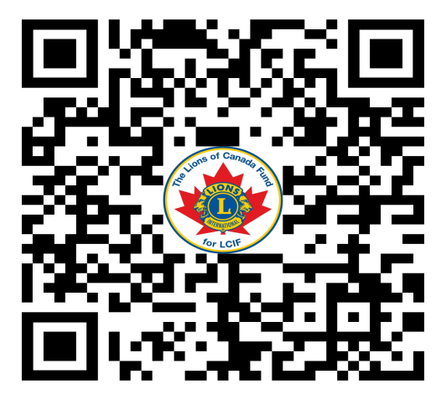
Club LCIF Coordinator
https://lionsofcanadafundforlcif.ca
Lions of Canada fund for LCIF
PDG Lion Stan DURWARD (Administrator)
Box 38 Sunderland ON L0C 1H0
lionsofcanadafundforlcif.ca
s.durward@sympatico.ca

Slide 20
Club LCIF Coordinator
Lions of Canada Fund for LCIF
Donations are sent, in Canadian Dollars, to LCIF Canada.
The funds are deposited into a Canadian bank.
You or your Club are eligible for MJF credits.
Donations can be designated to specific areas of need.
Individuals will receive Canadian tax receipts.
You can use your credit card to donate.

Slide 21
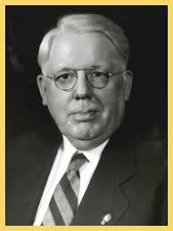
Club LCIF Coordinator
Melvin Jones Fellowship
The Melvin Jones Fellowship
(MJF) is the backbone of our
foundation. Presented to those
who donate US$1,000 to LCIF,
or to people for whom a donation
was made by others, it’s a tremendous contribution to humanity and to the legacy of our founder, Melvin Jones.

Slide 22
Club LCIF Coordinator
CATEGORYS OF LCIF GRANTS
Vision Grant Program
Matching
Diabetes
Disaster
Lions Quest
Designated
Leo
Community Impact
Hunger
Public Relations
Childhood Cancer

Slide 23
Club LCIF Coordinator
REMEMBER:
Your foundation works through a grant program, supporting the efforts of Lions Clubs worldwide.
Your Foundation does not fund government operations or agencies.
Who knows the needs of a community better than the local Lions Club?
We partner with other agencies, we do not work for other agencies.

Slide 24
Club LCIF Coordinator
The Portal- The Service Information you enter supports LCIF projects
The Portal data shows partnering agencies our commitment to a project.
If we are to convince other agencies we are serious, we require data to back up our claims of service and contribution.
Your project isn’t complete until the data is entered on The Portal.

Slide 25
Club LCIF Coordinator

Slide 26
Club LCIF Coordinator
LCIF is the foundation of Lionism
LCIF has a proven record of providing support
LCIF will continue to support the great ongoing need.
LCIF is an excellent and well accredited place to donate your hard won dollars
LCIF has provided support to our District well in excess of our contribution.
LCIF should be one of your preferred organizations for regular donations

Slide 27
Club LCIF Coordinator
Tony Davidson
District A15 LCIF coordinator
lcif@a15lions.org
519-732-9314
Template by Jim Devenny District A4

Slide 28
Club LCIF Coordinator
? ?
? ?
QUESTIONS?
?
? ? ?

Slide 29
Questions?
Jim DEVENNY
District A4 LCIF coordinator
23-08-14

