Slide 1

District A-15
New Member
Information Booklet

Slide 2
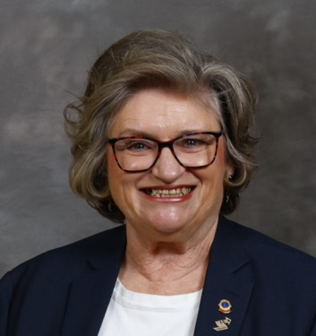
Dear New Members,
On behalf of District A15, it is with great pride and enthusiasm that we welcome you to the Lions family! By joining the world’s largest service organization, you are stepping into a community of compassionate, dedicated individuals who are committed to making a difference.
As a Lion, you have the opportunity to serve, lead, and inspire—both locally and globally. Whether it’s supporting vision programs, fighting hunger, protecting the environment, or empowering youth, your contributions will create lasting change.
We are excited to have you with us and look forward to working together to make our communities stronger. Your passion and dedication will be invaluable as We Serve with Kindness and Change the World Together!
Welcome to Lions! We can’t wait to see the impact you will make.
Yours in Service,
Linda Vinette
District Governor 2025-2026

Slide 3
Lions District A-15, located in Ontario, Canada, is known for its dedication to community service and humanitarian efforts. The district includes Lions Clubs from various communities, working together on impactful service projects that align with Lions International's global causes.
Key Service Projects in Lions District A-15
1. Vision & Eyeglass Recycling- Collecting used eyeglasses and distributing them to those in need. Supporting vision screening programs in schools and community centers.
2. Hunger Relief & Food Security-Organizing food drives for local food banks. Supporting meal programs for vulnerable populations.
3. Environmental Initiatives- Tree planting projects to promote sustainability. Community clean-up campaigns to enhance public spaces.
4. Childhood Cancer Support-Fundraising for childhood cancer treatment and research. Providing care kits and support for families facing a cancer diagnosis.
5. Diabetes Awareness & Prevention-Hosting diabetes screening events and awareness campaigns. Supporting local health initiatives focused on prevention and education.
6. Youth & Community Engagement-Sponsoring Leo Clubs to develop youth leadership. Supporting school programs and scholarships for students.

Slide 4
History of Lions Clubs International
Lions Clubs International (LCI) is the world’s largest service club organization, with a legacy of over a century in humanitarian service. Here’s a brief history of its origins, growth, and impact:
Founding and Early Years (1917-1920s)
Founded: June 7, 1917, by Melvin Jones, a Chicago businessman who believed that true success comes from serving others.
First Convention: Held in Dallas, Texas, in 1917, with the mission to foster a spirit of community service.
Expansion: By the early 1920s, Lions Clubs spread across the United States, and by 1920, they had expanded internationally with the first club in Canada in Windsor Ontario.
A Global Movement (1930s-1960s)
Sight Conservation: In 1925, Helen Keller challenged the Lions to become "knights of the blind," leading to a major focus on blindness prevention, vision care, and sight-related programs.
Growth: The organization expanded to Latin America, Europe, and Asia.
Leadership in Service: In the 1950s and 1960s, Lions Clubs helped establish humanitarian programs worldwide, such as disaster relief, education, and youth initiatives.
Modern Growth and Humanitarian Impact (1970s-Present)
LCIF (Lions Clubs International Foundation): Established in 1968 to provide grant funding for large-scale humanitarian projects, including disaster relief, medical programs, and global health initiatives.
Expansion into Health Initiatives: From eradicating river blindness to supporting diabetes prevention, Lions have played a key role in global health efforts.
Women in Lions: In 1987, Lions Clubs International opened membership to women, further strengthening its global impact.

Slide 5
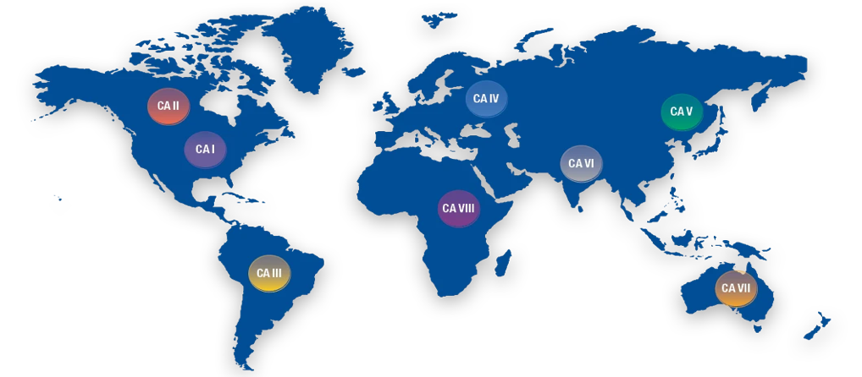
Global Causes: Today, Lions worldwide focus on eight key causes:
1. Vision (sight programs, eyeglass recycling, blindness prevention)
2. Hunger (food security initiatives)
3. Diabetes (awareness and prevention programs)
4. Childhood Cancer (support for affected families and research)
5. Environment (community sustainability projects)
6. Disaster Relief (support for communities devastated by natural disasters)
7. Youth (support young people so they can make positive choices, lead healthy and productive lives and become the next generation of service leaders)
8. Humanitarian (provide humanitarian aid where it is needed the most)
Present and Future
With over 1.4 million members in more than 200 countries, Lions Clubs International continues to lead global humanitarian efforts, emphasizing service, leadership, and community building.
Map of the 8 Constitutional Areas
CA1 (USA & Affiliates, Caribbean Islands), CA2 (Canada), CA3 (Latin America),
CA4 (Europe), CA5 (Orient & Southeast Asia), CA6 (India, South Asia, Middle East),
CA7 (Australia, New Zealand, Indonesia & Pacific Islands), and CA8 (Africa)

Slide 6
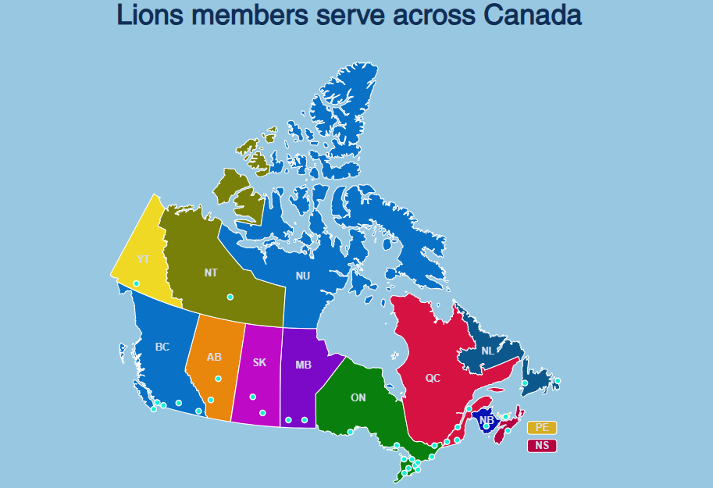

Slide 7
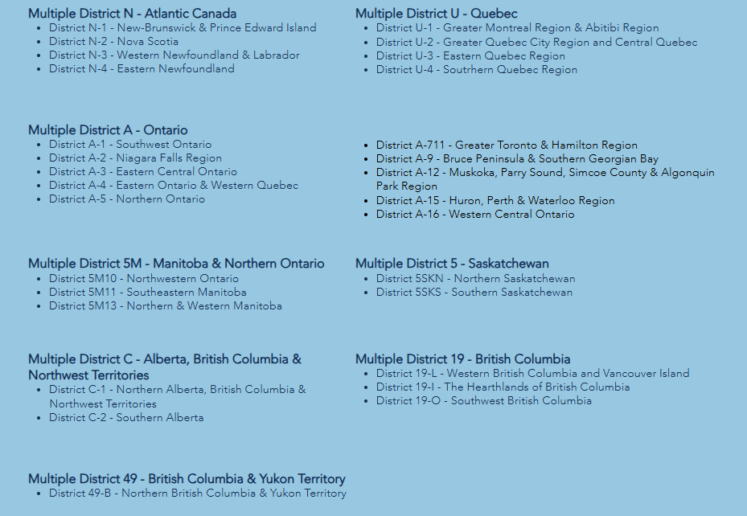

Slide 8
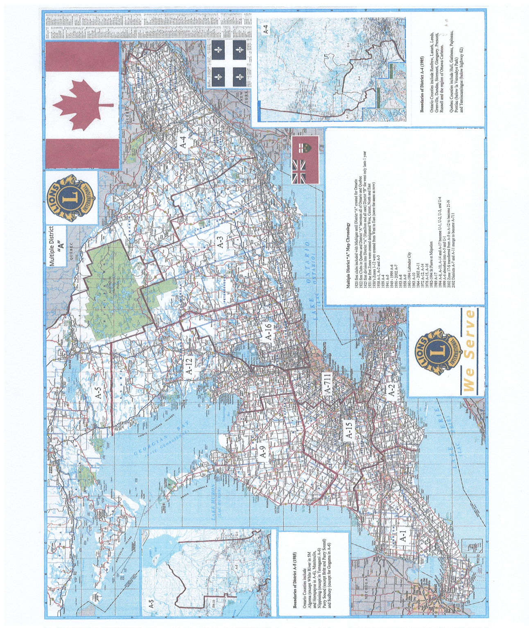

Slide 9
10 Lions Districts in Multiple District “A” MD"A" consists of 10 Districts, covering from Windsor to Cornwall, from White River to Mattawa, from Lake Erie to Hudson Bay in Ontario, and almost a dozen Clubs in Quebec from Buckingham near Ottawa to Chapeau near Petawawa. District A1-From Windsor to south of Grand Bend, and to London and St. Thomas District A2-From near Tillsonburg to Grimsby and Niagara-on-the-Lake and south District A3-From Courtice to past Kingston, north to Bancroft and Denbigh-Griffith District A4-From Gananoque to Cornwall, north past Ottawa to Petawawa and Barry's Bay, including portions of Quebec near Ottawa and Pembroke Petawawa. District A5-From White River, south to Sault Ste. Marie, and along the north shore of Georgian Bay through North Bay to Matawa, including a portion north to Moose Factory. District A9-Along Lake Huron from Goderich north, including the Bruce Peninsula, east from Goderich to Orangeville. District A12-Along the eastern shore of Georgian and Nottawasaga Bays from Britt south, to just west of Collingwood, south to Hwy 9, and north through Innisfil, Barrie and Orillia, and all of Muskoka. District A15- From Bayfield on the west to Marsville on the east, from Dundas in the east to Ingersoll, and west again to just north of Grand Bend. District A16-From Hwy#401, north to Muskoka, between Hwy #400 and Hwy #115, not including the Peterborough Area. District A711- City of Toronto, Brampton, Peel, Halton and parts of Brant and Wentworth.

Slide 10
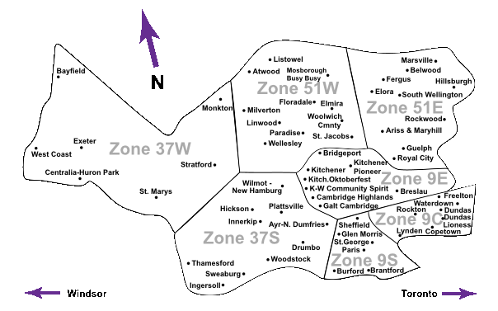
This is District A15

Slide 11
District A 15 consists of 3 Regions and 8 Zones
Regions 9, 37 and 51
In Region 9 there are 3 Zones with 21 clubs
9 East (9E) which has 8 chartered clubs
9 Central (9C) which has 7 chartered clubs
9 South (9S) which has 6 chartered clubs
In Region 37 there are 2 Zones with 17 clubs
37 West (37W) which has 7 chartered clubs
37 South (37S) which has 10 chartered clubs
In Region 51 there are 2 Zones with 21 clubs
51 East (51E)which has 9 chartered clubs
and 1 club branch
51 West (51W) which has 9 chartered clubs
and 2 club branches
District A15 has, at this time, 56 clubs and 3 club Branches with
approximately 1300 members … and growing!
(See image to the left for a list of the clubs in each Region/Zone)

Slide 12
The District Cabinet in Lions Clubs International plays a crucial role in leading and supporting clubs within a district. The cabinet ensures that clubs align with Lions International’s mission while fostering growth, service, and leadership development. Below are the key roles and responsibilities of the District Cabinet:
1. District Governor (DG)
The chief executive officer of the district.
Provides leadership, direction, and motivation to clubs.
Represents the district at international and multiple district levels.
Oversees district projects, membership growth, and service activities.
Presides over cabinet meetings and district conventions.
2. First Vice District Governor (1VDG)
Assists and supports the District Governor.
Prepares to assume the role of District Governor the following year.
Oversees district committees and special projects.
Attends leadership training and develops strategic district plans.
3. Second Vice District Governor (2VDG) Supports both the District Governor and 1VDG
Focuses on leadership development and membership growth.
Assists with district events and training sessions
4. Cabinet Secretary (CS)
Maintains official records of cabinet meetings.
Handles correspondence and communications within the district.
Ensures accurate reporting of district activities to Lions International.
5. Cabinet Treasurer (CT)
Manages district financial records and reports.
Oversees collection and disbursement of district funds.
Prepares financial statements and ensures financial transparency.
6. Region Chairs (Optional)
Supervise several zones within the district.
Provide guidance and leadership to Zone Chairs.
Act as a liaison between clubs and the District Governor.

Slide 13
7. Zone Chairs
Support and guide clubs within a specific zone.
Encourage collaboration and best practices among clubs.
Report club progress and challenges to the District Governor.
8. Global Action Team (GAT) Leaders (Non-Voting)
Global Leadership Team (GLT) Coordinator: Focuses on leadership development and training.
Global Membership Team (GMT) Coordinator: Works on membership growth and retention.
Global Service Team (GST) Coordinator: Oversees service projects and impact measurement.
Global Extension Team (GET)- Focuses on adding new clubs to the district
9. District Chairpersons (Committee Heads)(Non-Voting)
Lead specific district initiatives, such as:
Service Projects (Vision, Hunger, Environment, Childhood Cancer, etc.)
Membership & New Club Development
Leadership & Training
Public Relations & Marketing
Youth Programs (Leo Clubs, Peace Poster Contest)
LCIF Fundraising and Grants
Ensure clubs are engaged in relevant district and international programs.
10. Immediate Past District Governor (IPDG)
Acts as an advisor to the current District Governor.
Helps with leadership transitions and continuity.
May assist in special projects or mentorship roles.
These roles collectively ensure that the district operates efficiently, supports its clubs, and fulfills the Lions’ mission of community service and leadership development.

Slide 14
Lions Club members play a vital role in serving their communities and upholding the mission of Lions Clubs International (LCI). Their duties can vary depending on their club's activities and leadership positions, but here are the primary responsibilities:
General Duties of Lions Club Members
1. Service Participation – Engage in service projects, fundraisers, and initiatives that support global causes such as vision care, hunger relief, environmental sustainability, childhood cancer, and disaster relief.
2. Attending Meetings – Regularly participate in club meetings to stay informed, contribute ideas, and help plan events.
3. Community Engagement – Represent the Lions Club in the community, network with local leaders, and encourage participation in service efforts.
4. Membership Growth – Help recruit new members and mentor them to ensure they become active participants.
5. Fundraising Support – Assist in raising funds for service projects and humanitarian efforts.
6. Leadership Development – Take on leadership roles, such as club officer positions, to guide the club’s mission and operations.
7. Collaboration with Other Organizations – Work with local nonprofits, businesses, and government entities to maximize impact.
8. Promoting Lions International Values – Uphold ethics, integrity, and service-oriented principles in all activities.

Slide 15
Lions Club Leadership Positions and Responsibilities
1. Club President
Leads meetings and service activities.
Represents the club at district and international events.
Ensures the club meets its goals and follows Lions Club International guidelines.
2. Vice President
Assists the president and steps in when needed.
Oversees club committees and service projects.
3. Secretary
Maintains club records, meeting minutes, and correspondence.
Submits reports to Lions International.
4. Treasurer
Manages club finances, budgets, and fundraising proceeds.
Ensures financial transparency and compliance.
5. Membership Chairperson
Recruits and retains members.
Plans membership drives and orientation programs.
6. Service Chairperson
Organizes and promotes club service projects.
Ensures projects align with Lions International’s global causes.
7. Marketing/Communications Chairperson
Promotes the club’s activities through social media, press releases, and community outreach.
Helps build the club’s public image.
8. LCIF Chairperson
Promote LCIF Awareness, Fundraising and Grants
9. Tail Twister (Optional, for Fun & Morale)
Encourages enthusiasm, humor, and camaraderie in meetings.
Organizes small fun fines and club spirit activities.
10. Lion Tamer-(Optional)
Responsible for managing the club's property and paraphernalia. They act as the sergeant-at-arms during meetings

Slide 16


Lions Foundation of Canada - Dog Guides
LFCDG empowers Canadians living with disabilities to navigate the world with confidence and independence, by providing a Dog Guide at no cost and supporting them in their journey together. Located in Oakville, Ontario with a breeding and training facility in Breslau (between Kitchener and Guelph), we are the only school to train Dog Guides in seven distinct programs.
From breeding to rearing and training with a life-time of follow-up services, each Dog Guide is $35,000 to train and place. The Foundation relies on donations to provide these special matches and does not receive any government funding. Lions Foundation of Canada, 152 Wilson St. Oakville, ON L6K 0G6 T: 905-842-2891
Lions Quest Canada
The mission of Lions Quest Canada is to provide leadership, knowledge, and resources to develop healthy, capable young Canadians of strong character.
Initially, Lions Quest Canada distributed and promoted the Lions Quest School-Based Programs - Skills for Growing, Skills for adolescence, Skills for Action - and has expanded their offerings to include other training & products that support the implementation of a positive youth development approach in schools and communities.
Lions Quest Canada,
PO Box 2947, Stn Main St. Mary's, ON N4X 1A6
T: 800-265-2680 F: 519-624-1170

Slide 17

Lions of Canada Fund for Lions Clubs International Foundation (LCIF)
Since 1968, LCIF has given over US$1 billion in grants. Of those grants, many have come to Canada to help districts and club serve their communities. In fact, Canadian Lions have received more than we have given.
Dollars given to LCIF make possible “the power of we” – the power to let us do more by working together than working alone.
All funds raised will support Lions’ service in Vision, Youth, Environment, Hunger, Diabetes, Pediatric Cancer, Disaster Relief and other Humanitarian Causes. LCIF will continue to identify and develop new ways to make an impact on our world and its most vulnerable inhabitants.
100% of your donation empowers the compassionate service of Lions.
Lions of Canada Fund for LCIF,
22 Dundana Ave.
Dundas, ON L9H 4E6
1-630-203-3836

Slide 18
District A15 Service Committees Accessibility Committee Bulletin Editor and MDA Magazine Liaison Childhood Cancer Diabetes Awareness Environment Hunger Lions Clubs International Foundation
Lions Foundation of Canada Dog Guides Lions Quest Canada Peace Poster and Essay for
Visually Impaired Youth Vision
District A15 Administrative Committees
District Administrator Constitution & By-laws Convention Advisory Convention Host
Elections and Credentials Historian Honorary Committee Information Technology Leo Advisory Long Range Planning Nominations
Marketing Protocol and International Relations Video and Sound Facilitator

Slide 19
THE LIONS CODE OF ETHICS
TO Show my faith in the worthiness of my vocation by industrious
application to the end that I may merit a reputation for quality of
service.
TO Seek success and to demand all fair remuneration as my just due,
but to accept no profit or success at the price of my own self-respect
because of unfair advantage taken or because of questionable acts
on my part.
TO Remember that in building up my business, it is not necessary to
tear down another’s: to be loyal to customers and clients and true to
myself.
Whenever a doubt arises as to the right or ethics of my position or
actions towards my fellow kind, to resolve such action against myself.
TO Hold friendship as and end not a means. To hold that true
friendship exists not on account of the service performed by one to
another, but that true friendship demands nothing but accepts
service in the spirit in which it is given.
Always bear in mind my obligations as a citizen to my nation, my
province and my community. To give to them my unswerving loyalty
in word, act and deed. To give to them freely of my time, labour and
means.
TO aid my fellow kind by giving sympathy to those in distress, my aid
to the weak and my sustenance to the needy.
TO be careful with my criticism and liberal with my praise. To build up
and not destroy.

Slide 20
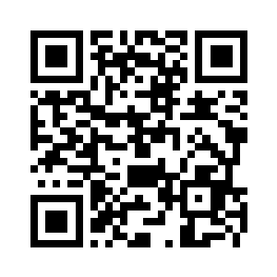
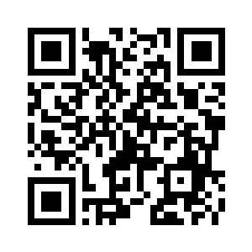
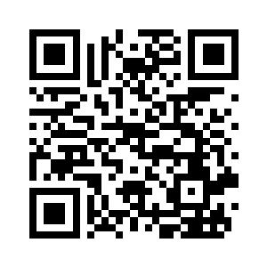
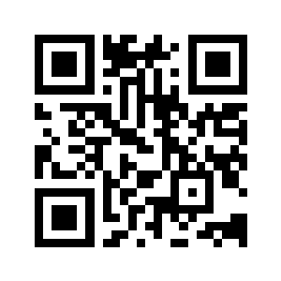
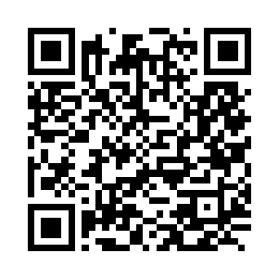
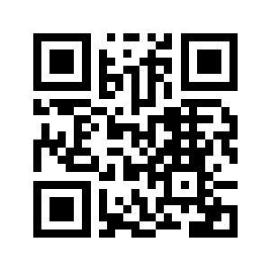
Lions Quick Links
District A15 Website
Lions of Canada
Fund for LCIF
Lions Clubs
International
Lions Foundation of
Canada Dog Guides
LCI Lion Portal
Lions Quest Canada

