Slide 1
Positioning, Re-Branding & the Lions Club
Marvin Ryder
Assistant Professor, Marketing & Entrepreneurship
DeGroote School of Business
McMaster University

Slide 2
Let’s Start with Some Consumer Behaviour
Brand Awareness!
A Little Exercise – Write down all of the luxury car manufacturer names that come to your mind!

Slide 3
The Product Ladder
If you are like most people, you wrote down three to seven brand names.
Why is this important?
1) Order Counts – the first name on the ladder gets twice the business of the second, and so on
2) If you are not on the ladder, you get very little business.
BMW
Cadillac
Audi
Porsche
Jaguar
Rolls

Slide 4
Positioning
The relative position a brand or company has on the amalgamated product ladders for all of the consumers in its target market.

Slide 5
Re-Branding
An attempt to change the relative position of an organization or brand on the product ladder.
Done to increase sales or capture a bigger share of the market.
Some classic examples.

Slide 6
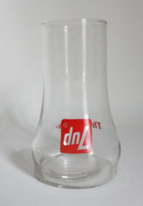
Re-Branding Example #1
Look closely at the glass.

Slide 7
Re-
Branding
Example
#2

Slide 8
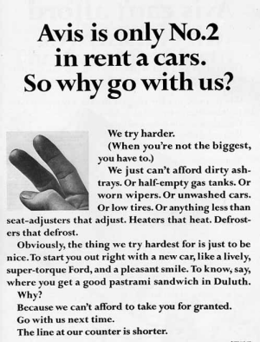
Re-Branding Example #3
Avis was NOT #2 when the ad appeared.

Slide 9
The “World” of Service Clubs
Name | Year of Founding | Motto | Membership | Clubs
Lions | 1917 | We serve. | 1,400,000 | 46,000
Rotary | 1905 | Service above self. | 1,220,000 | 34,282
Optimists | 1919 | Help Optimists help kids. | 87,000 | 2,900
Oddfellows | 1819 | Friendship, Love, Truth | 600,000 | 12,000
Masons | 1717 | Making good men better. | 5,000,000 | 50,000
Elks | 1868 | Elks care, Elks share | 1,000,000 | 2,200
Shriners | 1870 | Fun with a purpose. | 340,000 | 195

Slide 10
The “World” of Service Clubs
Name | Year of Founding | Motto | Membership | Clubs
Civitan | 1917 | Building volunteer leaders. | 40,000 | 1,000
Jaycees | 1915 | Be better. | 200,000 | 5,000
Knights of Columbus | 1882 | In service to one, in service to all | 1,850,000 | 15,000
Foresters | 1874 | Foresters cares | 1,000,000 | N/A
B’nai Brith | 1843 | Global voice of the Jewish community | 2,000,000 | N/A
Sertoma | 1912 | Service to man | 13,000 | 500
Zonta | 1919 | Advancing the status of women worldwide | 31,000 | N/A

Slide 11
The General Challenge
Membership in Service Clubs is Declining – Hard to get good estimates as each service club is private and any data released is unaudited. Best estimates – membership down 50% over last 30 years.
Aging Membership – Median age of service club members is in the 40’s. Lack of younger members filling the void.
Lots of Organizations – Good work in the community is not the sole responsibility of service clubs. In Canada, there are 85,600 registered charities and more than 200,000 other “not for profit” groups doing good.

Slide 12
What to do?
What position does Lions have now? – need to use objective data, ask hard questions, be brutally honest
What position does Lions want to have? – focused mission, easy to communicate, easy to understand, “unique”
Re-branding for Success – Everything should be on the table – Organization name, organization structure, governance, role of members, etc.

Slide 13
A Not-for-Profit Example
Canadian Tuberculosis Association
Founded in 1900
Sought a cure for and effective treatment of tuberculosis
In 1900, 180 out of 100,000 Canadians died of TB. Today it is less than 1 out of 100,000.
Public believed the “battle” was won so contributions declined
Canadian Lung Association emerged in the 1970’s with a broader mandate on “respiratory disease”
One constant – the Cross of Lorraine

Slide 14
Questions?
Marvin Ryder
Assistant Professor, Marketing and Entrepreneurship
DeGroote School of Business
McMaster University

